Slide 1
Project Ethereum
Presented to XYZ corporation

Slide 2
Group intro
Manikumaran
Responsible for developing the website
Manoghna
Project deliverables
Coordinate with Business analyst
Developer
Project Manager

Slide 3
Group intro
Abhishek
Documentations
Sarvesh
Data Acquisition
Data modelling
Business Analyst
Data Analyst

Slide 4

Project summary
Ethereum
Blockchain platform
Cryptocurrency (ETH)

Slide 5
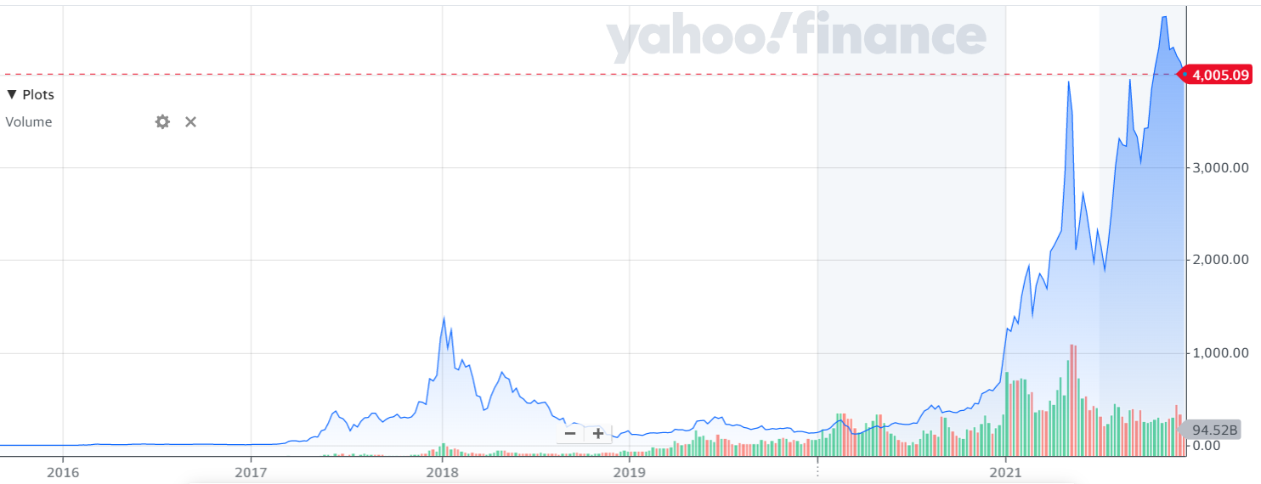
Ethereum trend
January 2014
Cryptocurrency (ETH)
Image Reference: https://finance.yahoo.com/quote/ETH-USD/chart?p=ETH-USD

Slide 6

Project Ethereum

Slide 7
Website Explanation

Slide 8
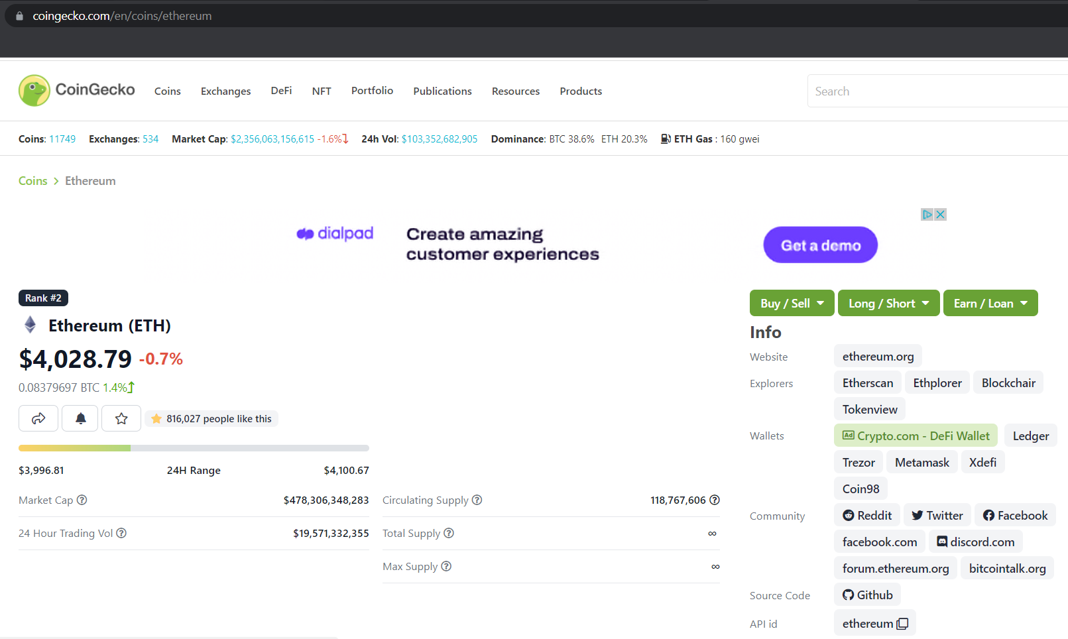
Implementation Details
Capturing the data
Data flow

Slide 9
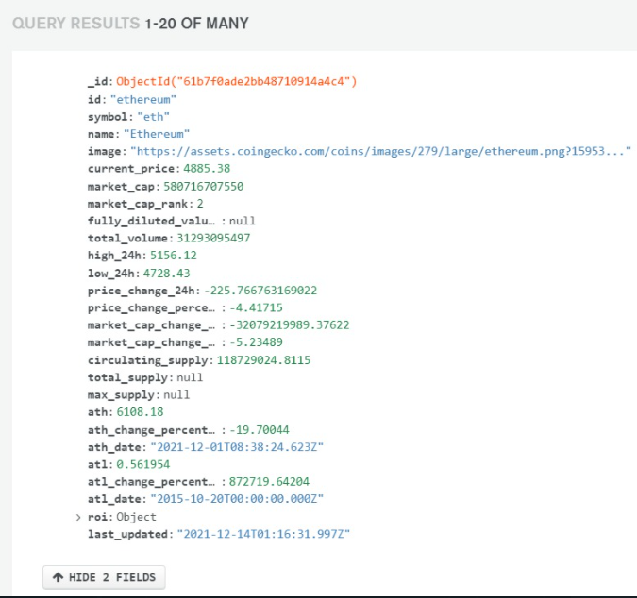
Data Reliability
Data Updates

Slide 11
Questions

Slide 12
Thank you!

